Slide 1
Student Seminar - IDP
Presentation 4
Can Ersoy - 20.10.2026

Slide 2
Extraction Grounding
How to make LLM cite it’s extractions?
Have it provide an evidence span, a text sequence (previous)
Have it provide the location on text, where it found the value (new)
Notes:
Feedback from last week -> citing location on fulltext

Slide 3
Location Annotations
Sequence/Paragraph/Sentence: We can augment paper full-text with location annotations
[sec-0] Background
[sec-0/p-0]
[sec-0/p-0/s-0] Cell culture techniques are an integral part of cell analysis.
[sec-0/p-0/s-1] Culture methods are often not a primary concern in growth studies, but rather a means to experimental results.
…
[sec-0/p-4]
[sec-0/p-4/s-0] An additional feature of the hydrogel makes it increasingly favorable for use within complex structures.
…
[sec-1] Results and Discussion
[sec-1/sec-0] Hydrogel Formation
[sec-1/sec-0/p-0]
[sec-1/sec-0/p-0/s-0] Hydrogel samples were created from a stock gelling agent of either 25 or 100 mg/ml.
[sec-1/sec-0/p-0/s-1] Successful gelling was performed in purified MilliQ water with both stock solutions.

Slide 4
LLM Grounding
With location annotations, LLM can just point to the location in text:
{"sequence":"[sec-1/sec-0/p-0/s-0]",
"type":"[sec-1/sec-1/p-0/s-3]",
"temperature":"[sec-3/sec-15/p-0/s-0]",
"solution":"[sec-1/sec-0/p-0/s-0]"}

Slide 5
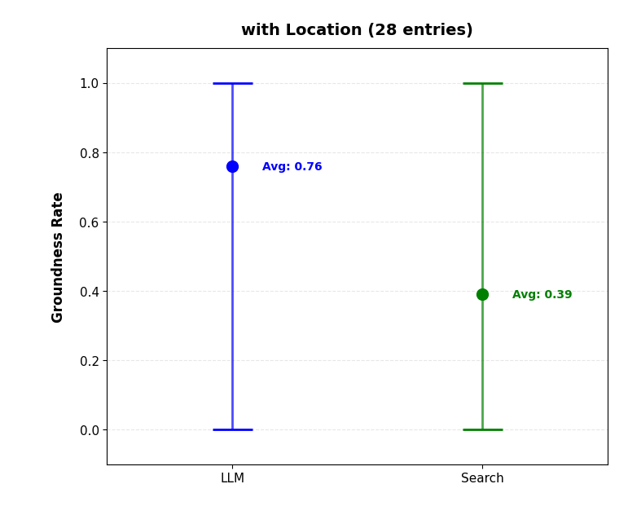
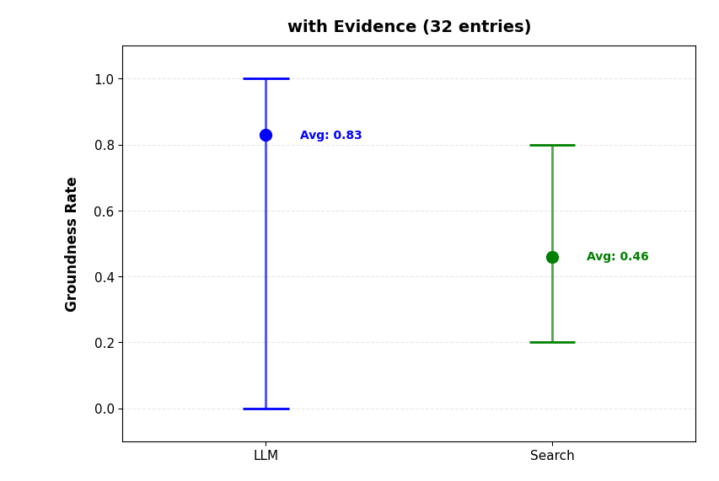
Results
Notes:
This slide shows the groundness check on entries from 10 papers
Since the entries needed to be created from scratch, there were a different number of entries (difference actually comes from a single paper interestingly)
It is meant to compare LLM based vs search based groundness on both with evidence and location based extraction
- llm approach seems more optimistic about groundness -> it doesn’t necessarily mean that it is doing a better job
LLM Based with evidence is basically -> faithfulness check from last week

Slide 6
Implementation
Since papers are already in XML, we can directly parse it to object trees:
(RootNode
(SectionNode
(ParagraphNode
(SentenceNode)
(SentenceNode)
…
Structural Nodes:
RootNode
SectionNode
ParagraphNode
SentenceNode
Special Nodes (not implemented yet):
TableNode
ImageNode
Notes:
For example image node can be used to retrieve images async way (there is no direct url inside xml for this)

Slide 7
Implementation (2)
Benefits of using an object tree:
Enables location based search
Provides a single interface over different types of full text content (JATS XML and TEI XML)
Allows to write utility functions to retrieve parts of text more easily
Special nodes (table/image) can improve/enable processing of tabular/visual data in the future

Slide 8
Implementation (3)
For PDF parsing, we can use grobid (https://grobid.readthedocs.io/en/latest/),
which returns the pdf in TEI XML format
For sentence recognition we can use scapy (https://allenai.github.io/scispacy/) with “en_core_sci_sm” model
Correct sentence segmentation is not essential but should increase extraction performance/grounding (it is done in a best-effort basis)

Slide 9
GPU Access
Another way of running big models: Google Colab (ollama)
Currently testing, has a limited usage capacity per month but should be useful
It is meant as a backup for GPU servers / Google AI API
Notes:
Basically current issue I see is llms using too many tokens even for small tasks like relevance check (20k tokens for 1k input max)
This means results can take a long time….

Slide 10
Next Steps
Identify what's making llm tasks slow and how it can be improved with the current setup (langchain/ollama)
Run pipeline properly
Add pdf -> TEI XML -> object tree transformation

